Slide 1
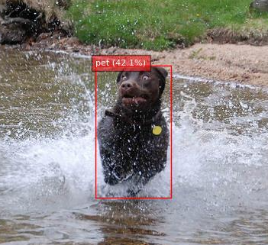
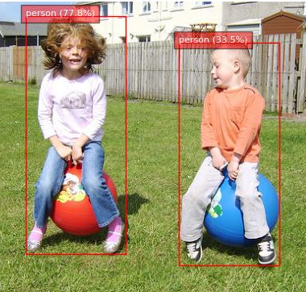
Introduction to Computer Vision - Final Project
Submitted by:
Iris Grabov
Roey Gilor

Slide 2
About As
We are two software engineering students at Afeka College, specializing in machine learning and artificial intelligence.
Iris Grabov is an academic reserve (Atuda) student serving in the Israeli military. Roey is an evening program student, balancing work and studies.

Slide 3
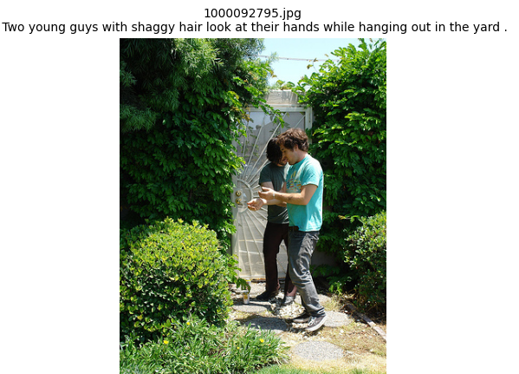
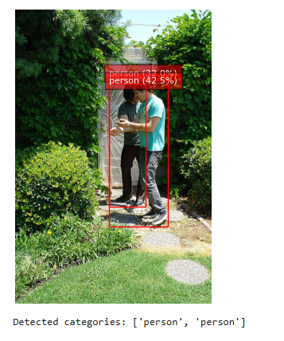
Part 1: Creating Training Dataset

Slide 4
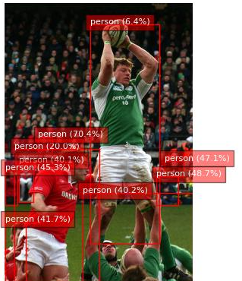
Filtering Threshold Decisions (640x480 Images)
Minimum Area (400 pixels²):
Filters out very small objects (smaller than ~20x20 pixels)
At 640x480 resolution, this represents ~3% of image width, ensuring objects are visible and learnable
Removes annotation noise while preserving small but valid distant people/pets
Maximum Area (150,000 pixels²):
Removes extremely large objects (larger than ~387x387 pixels)
Prevents objects larger than 60% of image width/80% of image height
Maintains focus on well-proportioned objects within the frame
Width Constraints (20-500 pixels):
Minimum (20px): ~3% of image width - preserves small objects while removing noise
Maximum (500px): ~78% of image width - allows large objects without spanning entire image
Height Constraints (20-400 pixels):
Minimum (20px): ~4% of image height - maintains small object detection capability
Maximum (400px): ~83% of image height - accommodates tall objects (standing people) while preventing full-frame boxes

Slide 5
Decisions Regarding Degrees of Freedom
The dataset generation pipeline applies several constraints to reduce variability and improve data quality:
Image filtering by minimum and maximum width and height ensures consistent input resolution.
Bounding box area thresholds remove extremely small or large detections that are likely noise.
Category filtering limits annotations to relevant classes ("person" and "pet"), reducing label noise.
Fixed train and validation sample counts per class ensure balance across splits.
Image filtering by size
min_box_area = 400 # pixels² (minimum object area) max_box_area = 150_000 # pixels² (maximum object area) min_width, max_width = 20, 500 # pixels width range min_height, max_height = 20, 400 # pixels height range

Slide 6
Filtering Threshold Justification
The chosen filtering thresholds (min_box_area=400, max_box_area=150,000, width range 20-500px, height range 20-400px) were carefully selected to balance data quality and quantity for our 640x480 image dataset.
The minimum dimensions of 20 pixels preserve small but valid objects such as distant people and small pets, which represent approximately 3-4% of the image dimensions and are commonly encountered in real-world scenarios.
This threshold effectively filters out annotation noise while maintaining the diversity of object scales necessary for robust detection performance.
The maximum constraints (500px width, 400px height) ensure we focus on well-localized objects rather than scene-level annotations, preventing boxes that span most of the image frame.
The area constraints further reinforce these boundaries, creating a dataset that emphasizes properly bounded objects suitable for training an efficient detection model.
This conservative approach prioritizes annotation quality over quantity, which is crucial when using Florence-2 generated labels to train a smaller, more efficient model for deployment scenarios.
Category filtering The dataset focuses only on "person" and "pet" categories. These were chosen as relevant, well-defined, and frequently occurring object types in the source dataset. Labels were mapped using keyword matching to ensure consistency across the Florence-2 free-text outputs.

Slide 7
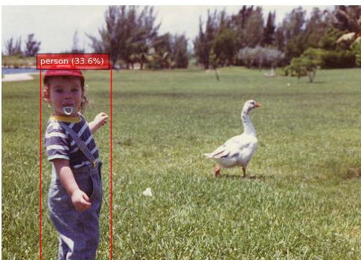
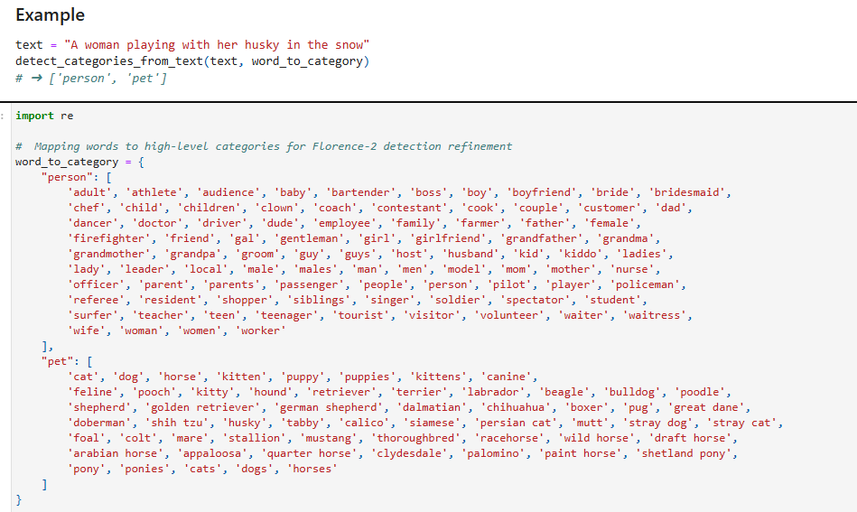
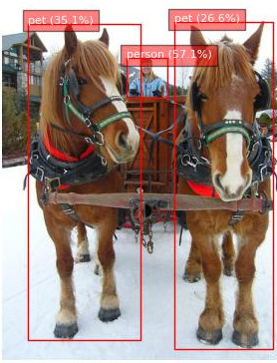
Keyword-Based Mapping

Slide 8
How TTA (Test-Time Augmentations) Can Help Verify Annotations
Test-Time Augmentation (TTA) involves applying various transformations (such as flipping, scaling, and rotating) to an image during inference and aggregating the predictions.
To verify annotation correctness using TTA:
Apply different augmentations to the same image and run inference.
Reverse the augmentations on the predicted boxes to match the original image space.
Compare the resulting predictions to the ground-truth annotations.
If the annotations are correct, predictions from various augmentations should consistently align with the labeled objects. Inconsistencies may indicate missing or incorrect annotations, or label ambiguity.

Slide 9
How Ensembles Can Help Validate Training Annotations
Ensembling combines the outputs of multiple models (trained independently or with different architectures).
To validate annotations with an ensemble:
Run multiple trained models on the same training image.
Combine predictions (e.g., using non-maximum suppression with averaged scores).
Compare the ensemble’s aggregated prediction with the annotated labels.
Significant discrepancies between the ensemble output and the annotations may suggest labeling mistakes, such as missing boxes or incorrect class assignments.

Slide 10
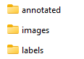
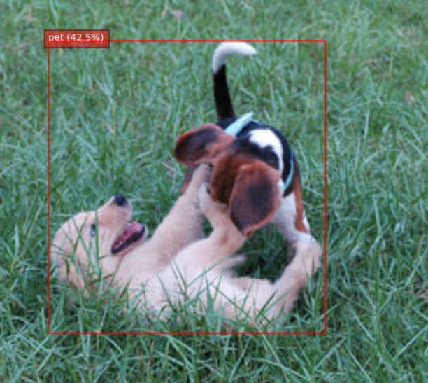
We think that we can solve that kind of problem by using Language model
The description of the picture refers to 2 dogs: a Golden Retriever and a Beagle playing together - meaning it can be understood that there are 2 dogs in the picture and not one for sure!
The problem is that we have limited resources.
Deleted :

Slide 11
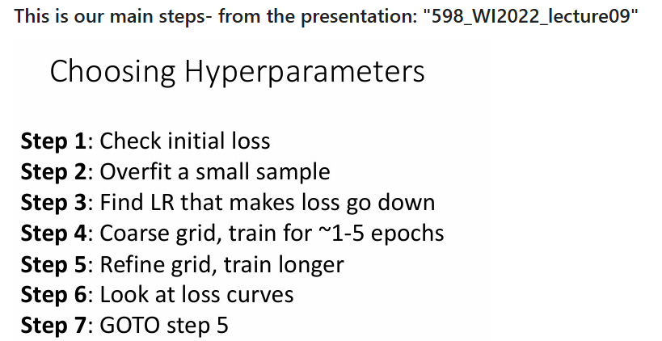
Part 2: Training YOLO model

Slide 12
Workflow Overview:
Step 1: Initial Loss Check Run a one-epoch training session to verify that the model is learning and observe early loss behavior.
Step 2: Baseline Model (Default Settings) Train for 50 epochs with default hyperparameters to understand baseline performance and overfitting patterns.
Step 3: Learning Rate Sweep Test multiple values for lr0 and select the one that leads to stable and consistent loss reduction.
Step 4: Coarse Grid Search Explore combinations of weight_decay, optimizer, and augmentation using short (5-epoch) runs to identify strong candidates.
We compare with and without augmentation
Step 5: Refined Grid Search Take the best configuration from Step 4 and train for 10 full epochs for deeper convergence.
Step 6: Visual Inspection Manually review model predictions to validate performance and identify failure cases.
This structured approach allows us to confidently select a high-performing and stable model ready for production or deployment.

Slide 13
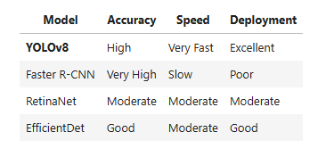
Model Selection: Why YOLOv8?
Fast and Accurate: As a one-stage detector, YOLOv8 achieves high accuracy while maintaining fast inference speeds.
Edge-Ready: Optimized for real-time performance, making it suitable for deployment on resource-constrained devices.
Ultralytics Ecosystem: The official YOLOv8 implementation offers a unified interface for training, evaluation, and exporting models in formats like ONNX or CoreML.
Built-in Augmentations: YOLOv8 includes strong augmentation options and easy customization.

Slide 14
Apply Advanced Augmentations and Regularization
Based on Lecture 9 (Slides: Data Augmentations Used in Practice) and Lecture 4 (Regularization & Optimization), we now introduce:
RandAugment, MixUp, Mosaic, CopyPaste, HSV jitter, Erasing
Weight Decay: Helps reduce overfitting
Dropout: Applied inside model for regularization
Patience: Enables early stopping if val performance stagnates

Slide 15
Data Augmentation Strategy
Horizontal Flip (fliplr=0.5) Helps the model learn mirror symmetry and prevents overfitting to object orientation.
Color Jitter (hsv_h=0.015, hsv_s=0.7, hsv_v=0.4) Adjusts hue, saturation, and brightness to simulate varying lighting conditions.
Cutout / Random Erasing (erasing=0.4) Randomly occludes parts of the image, forcing the model to learn robust features.
MixUp (mixup=0.2) Blends two images and their labels, encouraging smoother decision boundaries.
CopyPaste (copy_paste=0.1) Pasts objects from one image into another, augmenting object composition.
Mosaic (mosaic=1.0) Combines four images into one during training, increasing contextual variety.
RandAugment (auto_augment='randaugment') Applies a randomized combination of geometric and photometric transforms.
Translate and Scale (translate=0.1, scale=0.5) Simulates camera motion and object scaling, enhancing robustness to position and size.

Slide 16
Step 2: Overfit Small Sample
Why This Matters
If the model fails to overfit on a small dataset, it indicates:
A bug in the pipeline,
Incorrect loss configuration or augmentations,
Or that the model is underpowered or restricted.

Slide 17
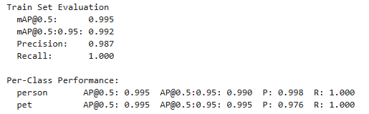
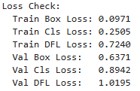
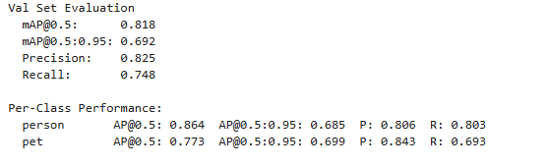
Results

Slide 18
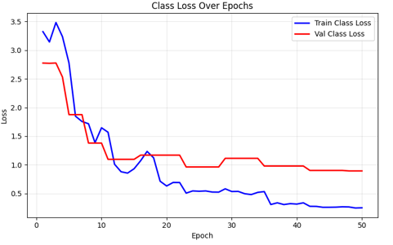
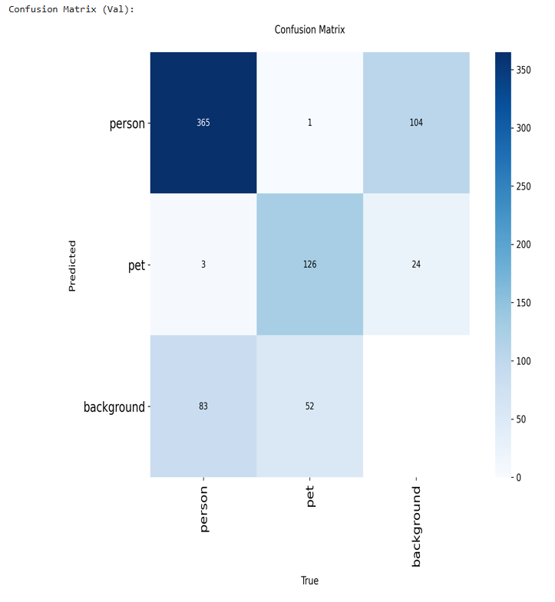
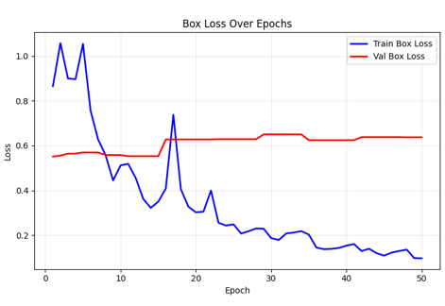

Slide 19
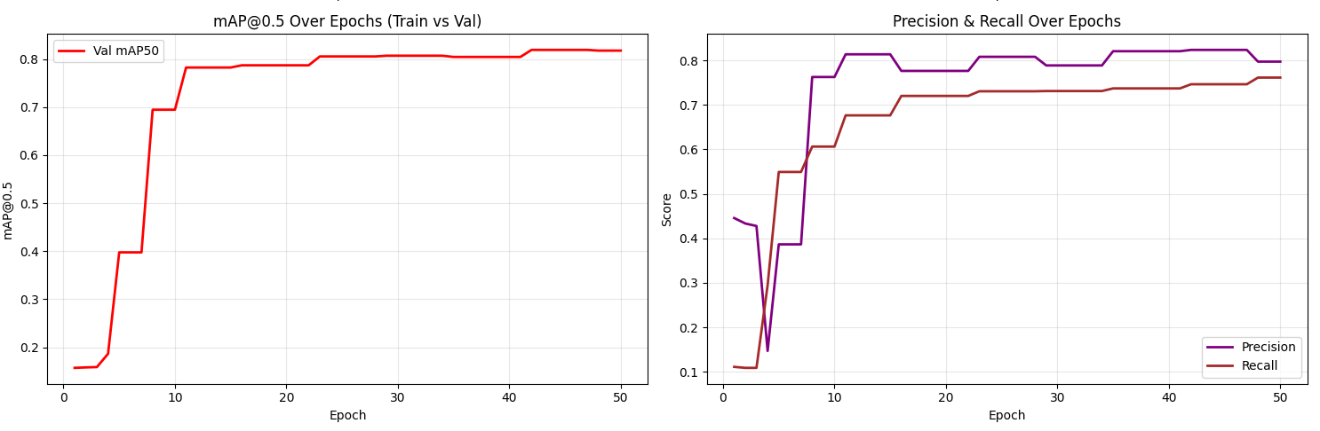
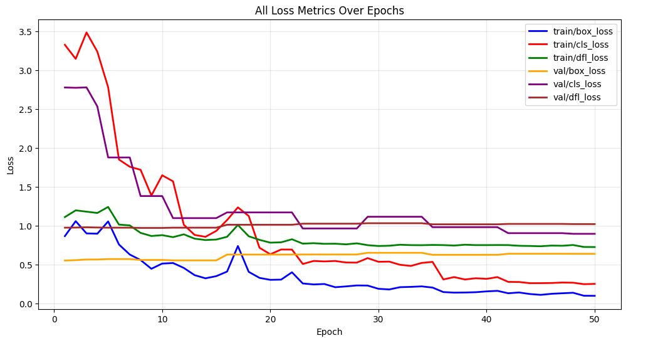
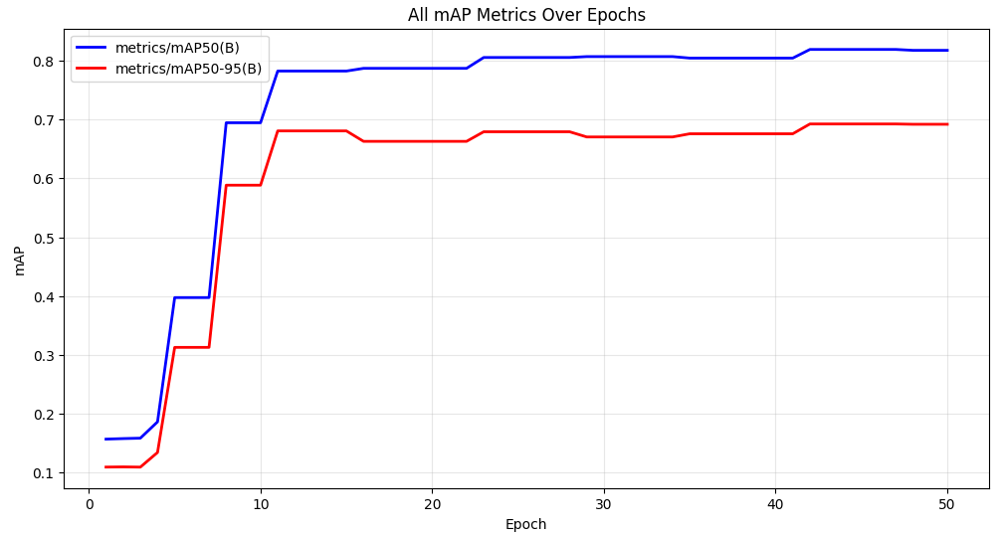

Slide 20
Step 3: Find Learning Rate That Makes Loss Go Down

Slide 21
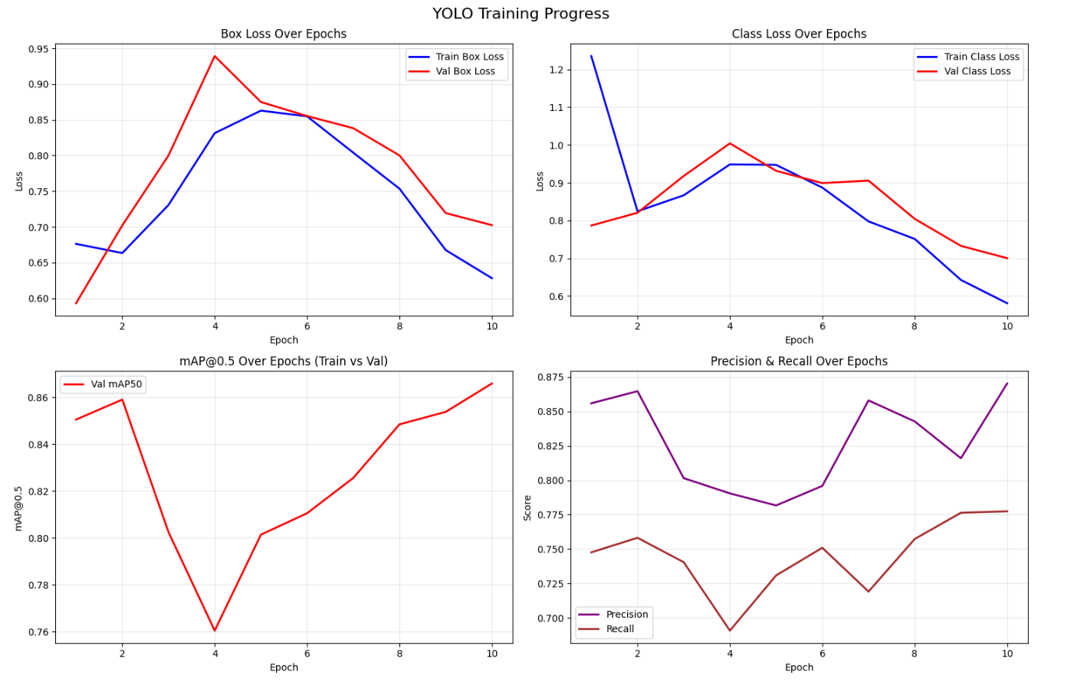
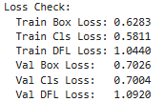
1e-2

Slide 22
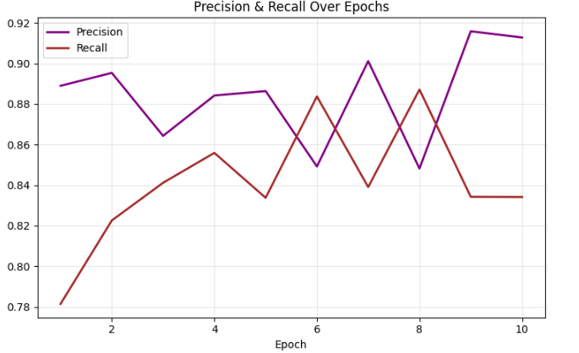
1e-3

Slide 23
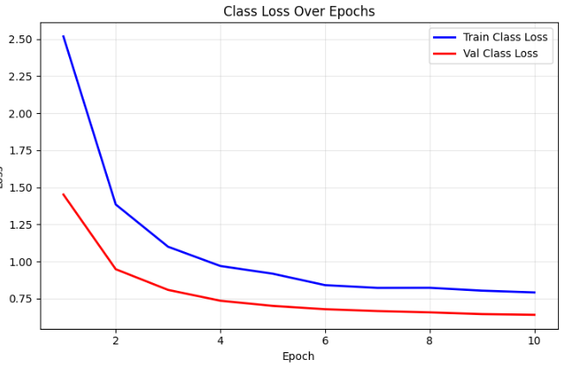
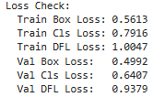
Learning Rate Sweep – Choosing lr0 = 1e-4

Slide 24
Step 4: Coarse Grid Search – 1 to 5 Epochs
In this step, we run a coarse grid search to evaluate how different combinations of optimizer, weight decay, and augmentation affect training performance during the first 5 epochs.
We fix the learning rate at lr0 = 1e-4 (based on Step 3) and vary the following:
Weight decay: [1e-2, 1e-3, 1e-4]
Optimizer: ['SGD', 'AdamW']
Augmentation: use_aug = True / False

Slide 25
grid_lr1e-04_wd1e-02_SGD_aug
grid_lr1e-04_wd1e-02_SGD_noaug
grid_lr1e-04_wd1e-02_AdamW_aug
grid_lr1e-04_wd1e-02_AdamW_noaug
grid_lr1e-04_wd1e-03_SGD_aug
grid_lr1e-04_wd1e-03_SGD_noaug
grid_lr1e-04_wd1e-03_AdamW_aug
grid_lr1e-04_wd1e-03_AdamW_noaug
grid_lr1e-04_wd1e-04_SGD_aug
grid_lr1e-04_wd1e-04_SGD_noaug
grid_lr1e-04_wd1e-04_AdamW_aug
grid_lr1e-04_wd1e-04_AdamW_noaug
12:

Slide 26
Executive Summary
After training and evaluating 12 different YOLO model configurations across various optimizers, weight decay values, and augmentation settings
grid_lr1e-04_wd1e-04_AdamW_aug .
Model: grid_lr1e-04_wd1e-04_AdamW_aug
Learning Rate: 1e-4
Weight Decay: 1e-4
Optimizer: AdamW
Augmentations: Enabled

Slide 27
Augmentation Impact
Data augmentation shows interesting patterns:
For AdamW:
With augmentation: Better validation performance Without augmentation: Higher training performance but risk of overfitting
For SGD:
Minimal difference between augmented and non-augmented versions
Suggests SGD may need different augmentation strategies

Slide 28
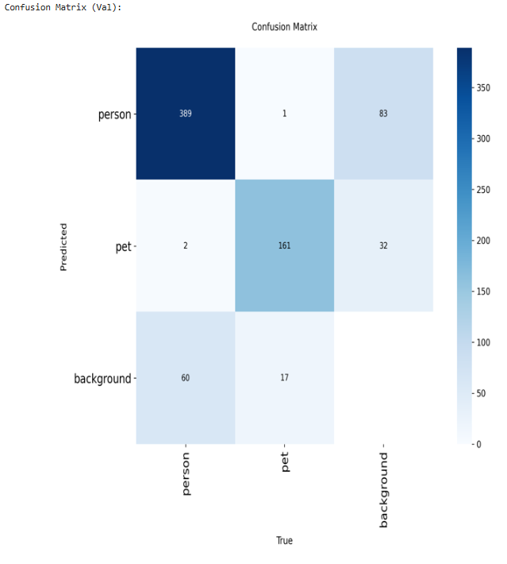
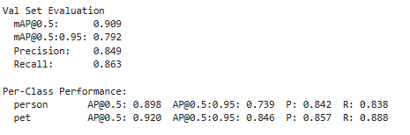
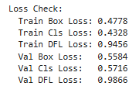
Step 5: Refined Grid Search – Extended Training Step 6: Look at loss curves

Slide 29
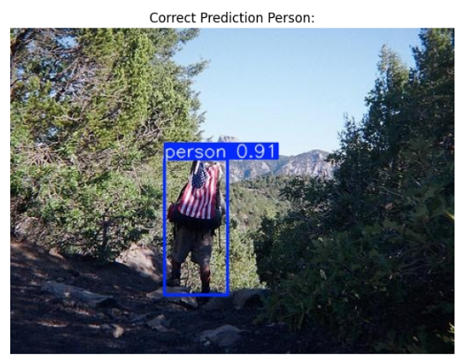
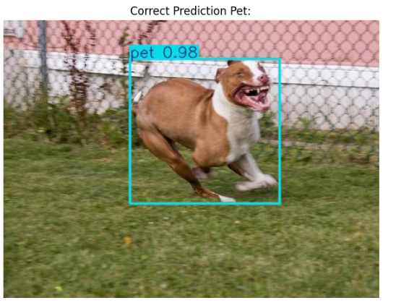
Visual Inspection – Model Predictions

Slide 30
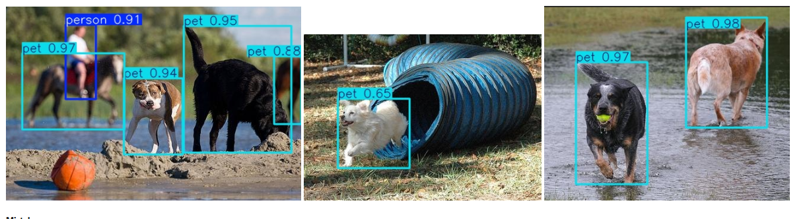

Slide 31
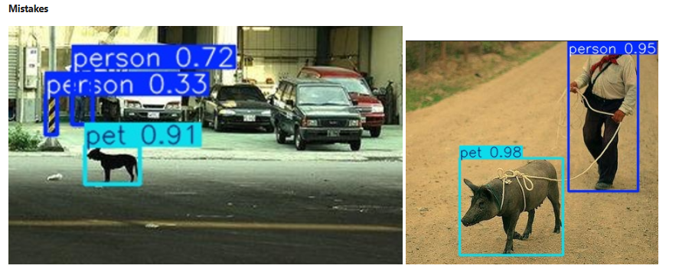

Slide 32
Prediction Mistakes – Error Analysis
In the left image, the model correctly detects the presence of a pet (likely a dog) and two person objects. However, one of the person detections is low-confidence (0.33),
likely a false positive due to background clutter or shadow patterns that resemble a human form.
In the right image, the model detects a person and a pet with high confidence. However, the pet detection is incorrect — the object is a pig,
which does not belong to the defined pet class (which includes only dog, cat, and horse). This is a semantic misclassification that highlights a weakness in category boundaries,
especially when visually similar animals fall outside the class list.
These examples illustrate the importance of refining class definitions and ensuring the model does not overgeneralize visual patterns to incorrect categories.

Slide 33
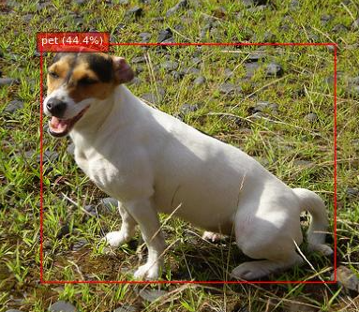
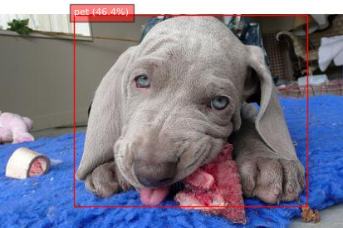
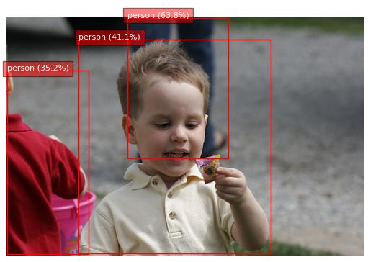
Thank you for listening

